Slide 1
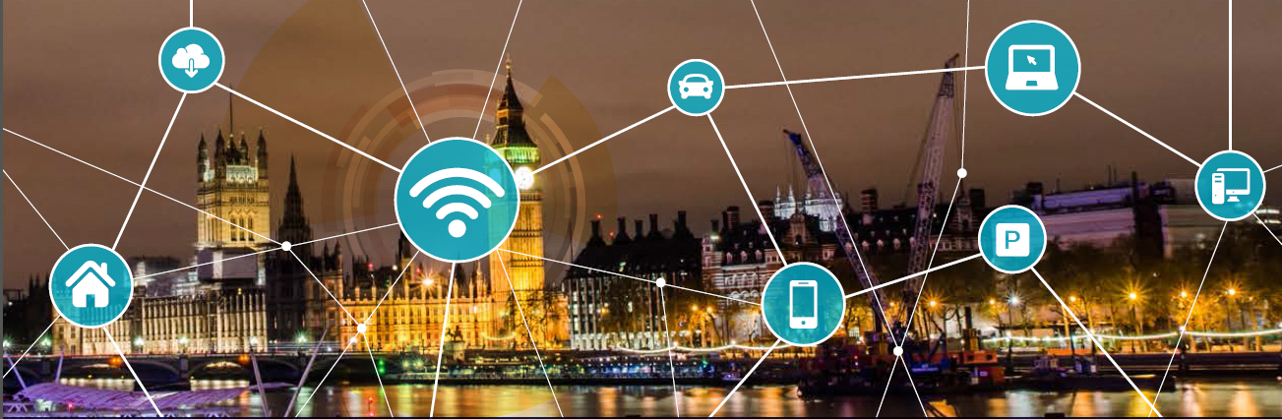
Smarter Parking
DfT Hosted Connected Vehicle Deployment Day
24th May 2017
Kieran Fitsall
Head of Service Improvement & Transformation

Slide 2

The Westminster Connected Parking Project
Funded by DfT to build on Westminster investment
Collaborative working with providers
  Make most of existing data from sensors
  Explore other sensor technology
  Integrate payment with parking spaces into vehicle and app
  Use Big Data to improve operations and inform policy making
  Make parking easier
DfT want lessons learned to be spread to other UK LAs
  Blueprint, setting the standard
  National relevance for future initiatives

Slide 3
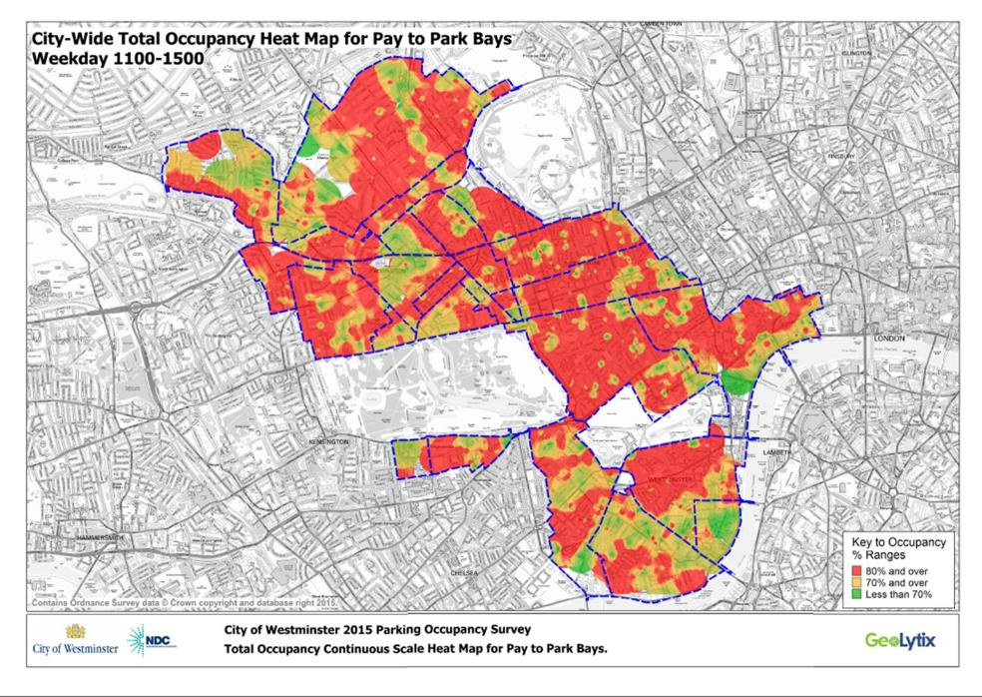

Slide 4
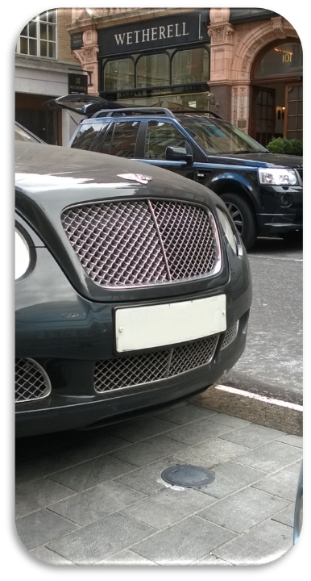
Sensors
In ground
Tailor to application
  Monitor spaces or rows?
Vehicles and statistics can be “sensors” too
  Drivers only need one space
If we know how to manage sensor data and vehicle data…
  Support Mobility as a Service
  Assist autonomous vehicles (surely they will need to park sometimes)
Taxi bay sensors from Clever Citi being installed
  Collecting stakeholder input

Slide 5
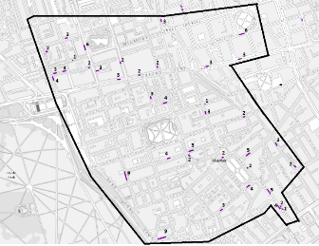
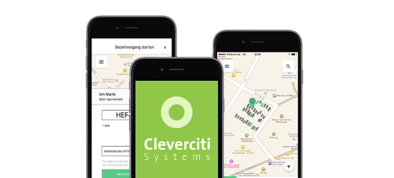
Optical sensors
Tell drivers where there is already over ranking
Balance out service
Tell customers where there is a taxi?

Slide 6
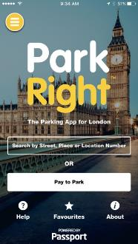
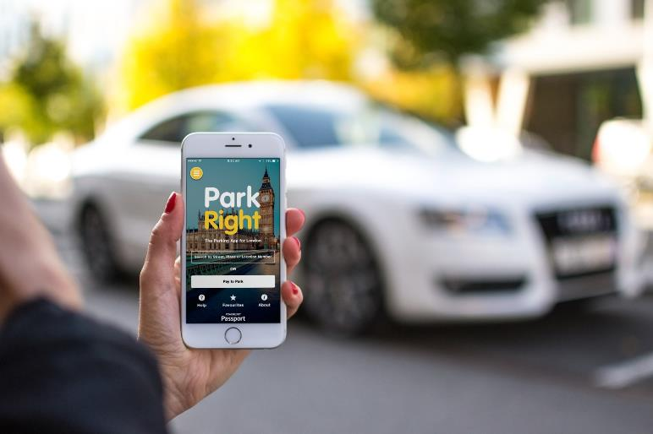

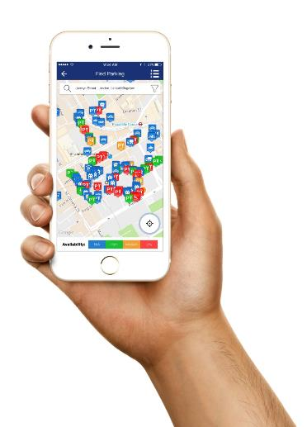
Real-time parking availability
Millions of vehicle movements from 3500 bays

Slide 7
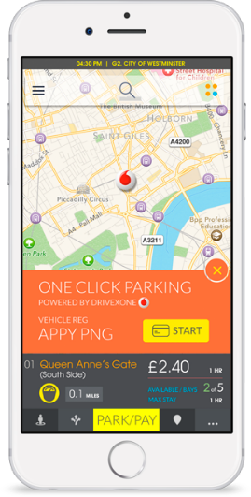

Payment
The key to one touch payment
  Customer happiness
Need to allow for many different ways to pay
  Make it invisible to the user
Make it simple to pay and to stop paying
  Dongle or movement sensor in phone/ vehicle
  One Click parking - Don’t rely on people!
Refunds, customer care etc – think about the detail
of the customer journey

Slide 8
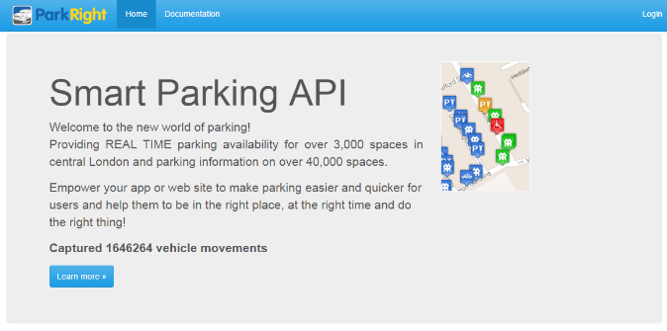

Open API
Parking bay location – Street
and electoral ward/districts
Parking bay capacity
REAL TIME availability
GPS longitude and latitude
The type of parking bay – Disabled, paid, residents, loading
Parking tariff that apply to paid parking bays
Hours of operation for all bays
Details to allow users to pay to park by mobile phone
LIVE parking suspension details
  So your self driving car doesn’t try and park in a suspended bay

Slide 9
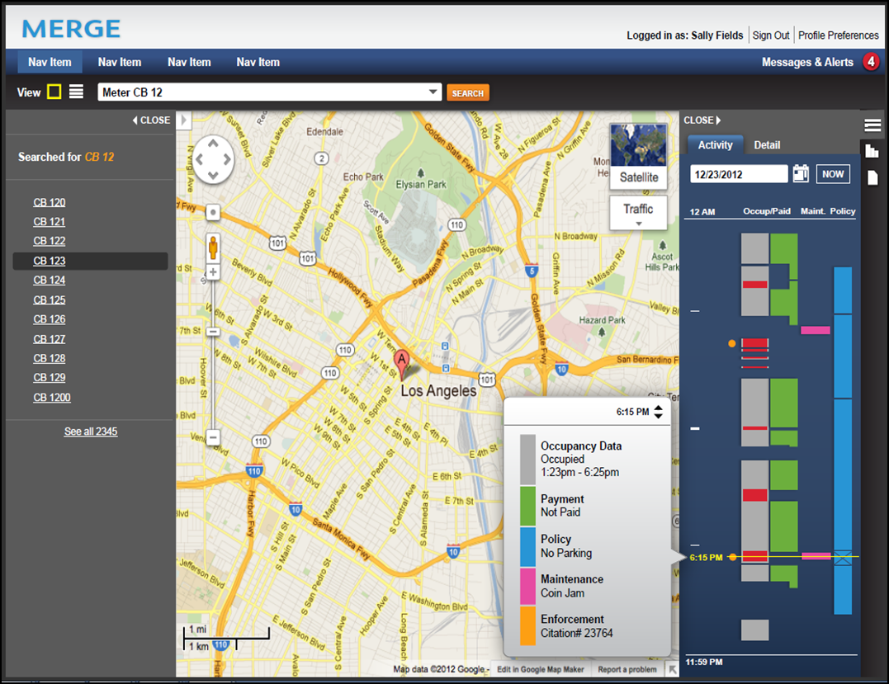
Big Data
What does data tell us about parking use?
Can we improve operations and policy?
How do we improve
  enforcement / customer experience?
Xerox Merge tool coming on line
  Combines data that drives parking
  What if?
  Uses data catalogue produced in the project to fuse all data
In LA, Xerox’s data approach has
  extended time limits from 2 to 10 hours in the most underused spaces, leading to an increase in parkers
  Paid use improved by 18%
  revenue improved by 22%
Hackathon next year

Slide 10
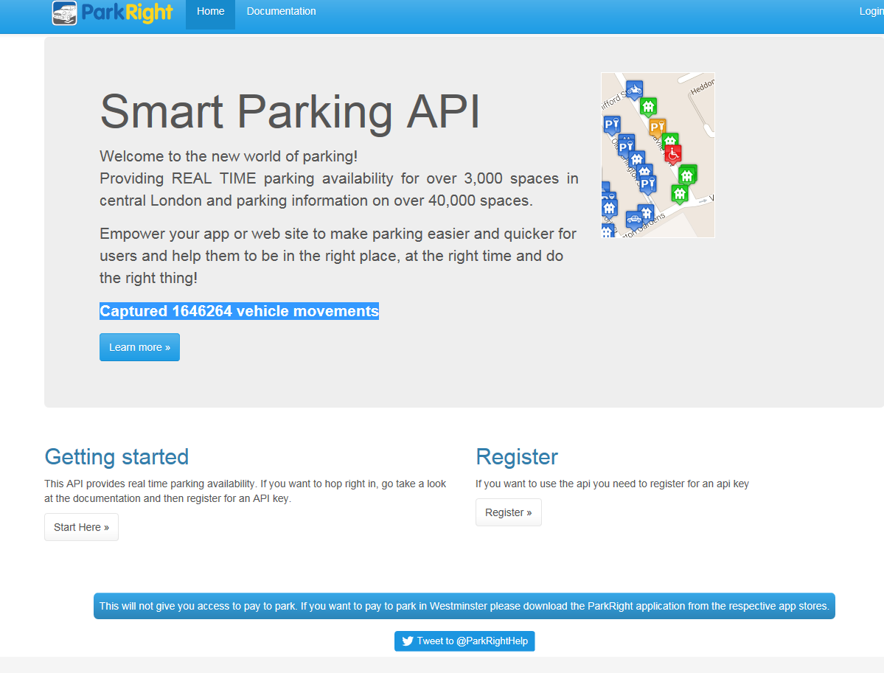
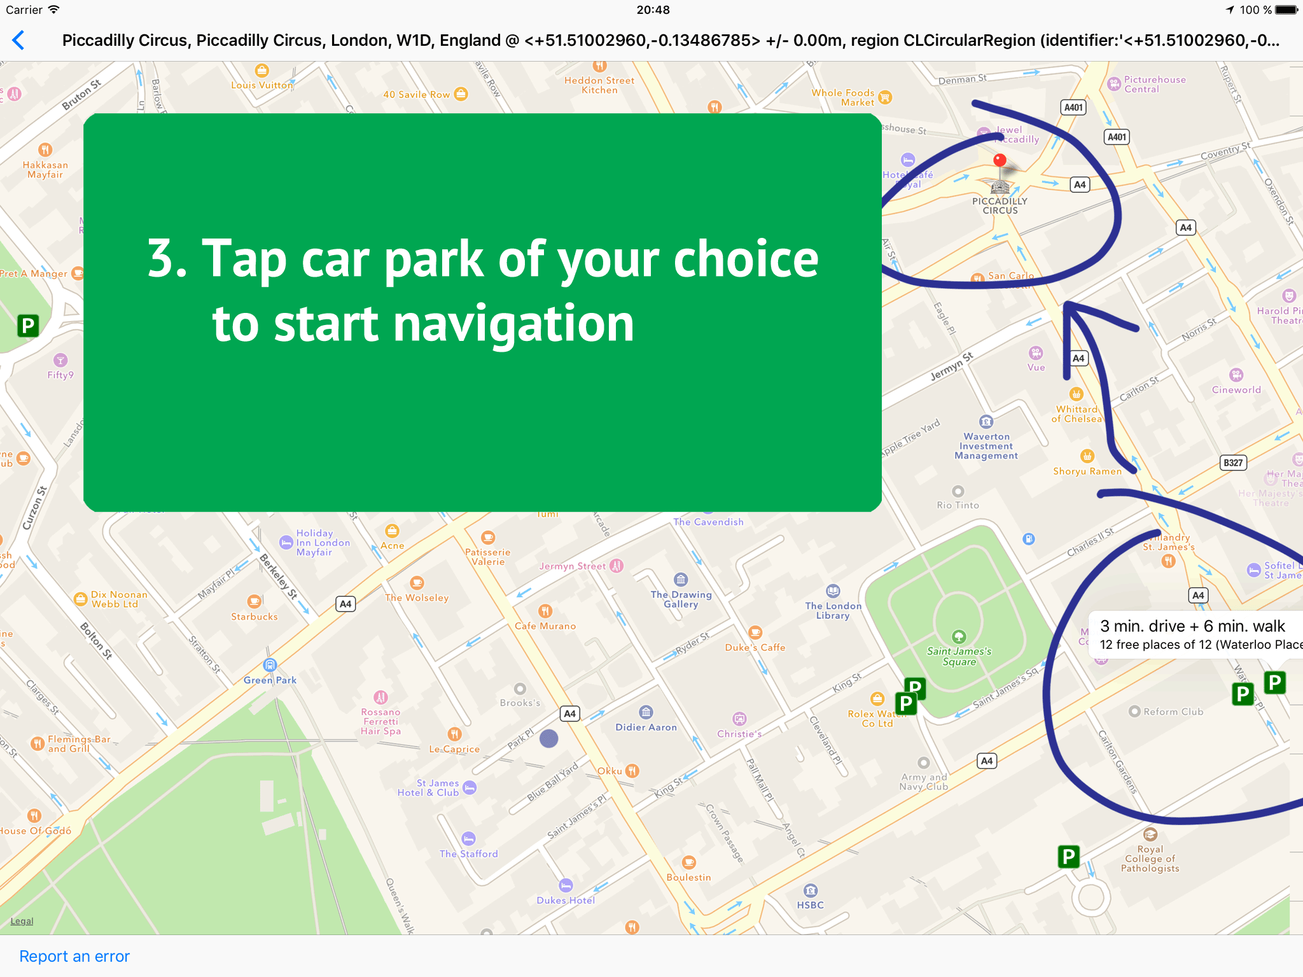
Next Steps: Open Data
Put it out there for others to use
  https://api.parkright.io/
  Publish data and open API
  Over 100 users registered
  Park in London and Moscow!
Make a catalogue
  Not just your parking data
Make it available
Find out who uses it and what they do with it
Lesson learned
  Need a critical mass of sensors & data
  One Borough, One City, One nation..
  Interoperability
  Standards

Slide 11
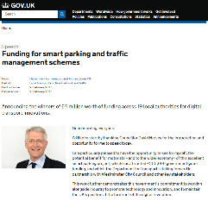
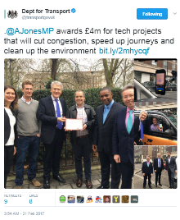
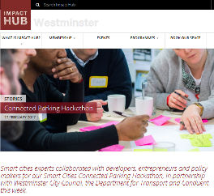
Overall Benefits
Solutions have the potential to save motorists
time, stress, money, while dramatically
increasing productivity
Cities benefit from reduced traffic, congestion and pollution
More efficient use of on-street resources
Motorists spend less time searching for parking
Better balance of bay occupancy across the network
Improved customer experience and ease of payment

Slide 12
Next steps …
Sensors and Apps deployed - first results coming soon
Lessons learned paper for DfT to share with other LAs
Parking data standards and LA implications
  How do we balance market agility with interoperability?
  Working with BPA on their Parking 20:20 vision
  Must avoid one app per city

Slide 13

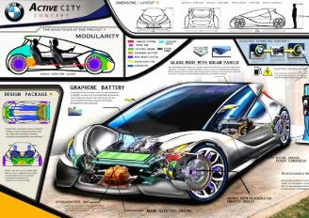
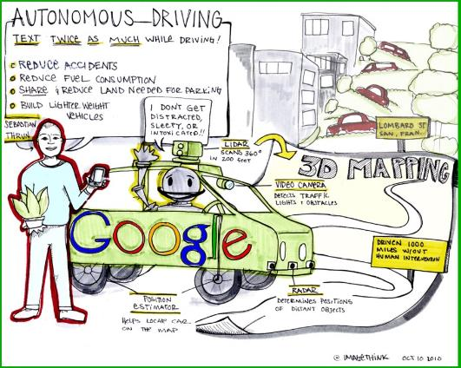
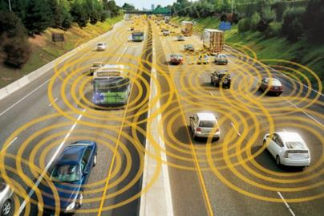


Kieran Fitsall
kfitsall@westminster.gov.uk
@kfitsall

